Slide 1
My Alien Encounter
GROUP 2
Alice Baker Elliot Chester Heidi Falcon

Slide 2
The Game
It has been created to meet the requirements of Obscure Sorrows brief. Vellichor and Chrysalim.
The story line of the game is based on an alien visiting earth for its second time and searching for a book.
The games offers simple fun and simple mechanics to a demographic of adults 18- 27 both male and female.

Slide 3
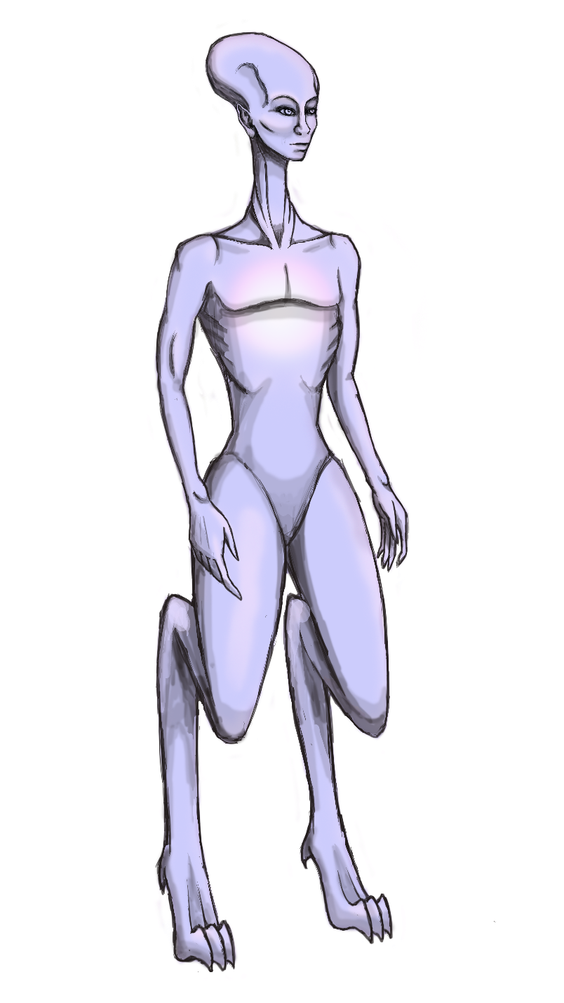
The Alien
The player would be an alien that uses electricity as its food source and with the power of invisibility.
This alien is created human like so it adapts to the environment. It is androgynous.

Slide 4
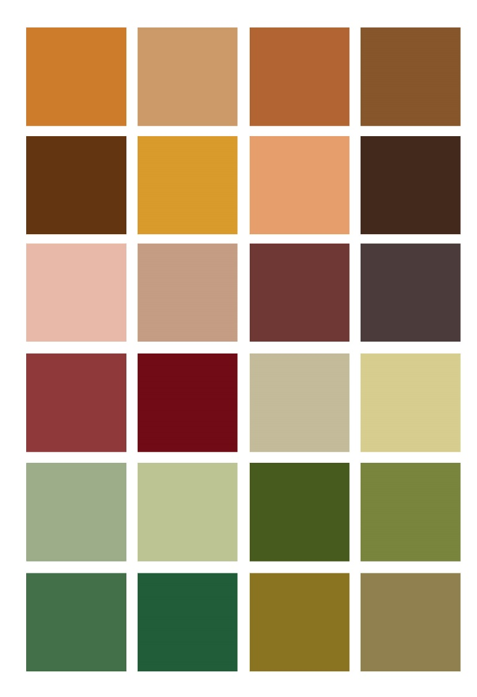
The Alien’s Environment
The game is inspired on the Victorian era.
Electricity in buildings was sparse. This adds difficulty to the game.

Slide 5
The Mechanics
The game has three levels and the player has 10 lives at the beginning of the game. Each level has an added element of difficulty.
As the buildings don’t have electricity the alien can only feed from the thunder in the storm.
The game ends when the alien finds the book, contacts its spaceship and returns to its planet.

Slide 6
Any Questions?

